Slide 1
High boosting filter

Slide 2
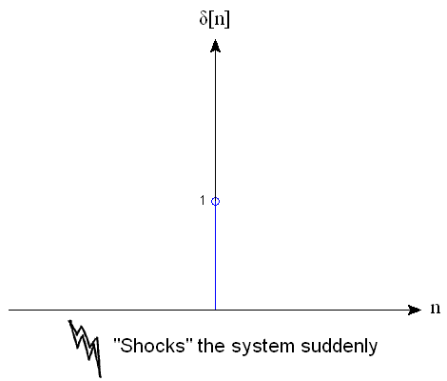
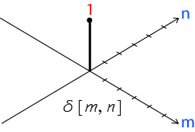
Background Knowledge
In our course, we studied in 2D only
In the image processing, we will focus on 3D because image has columns and rows or pixel

Slide 3
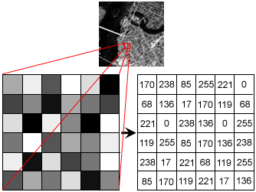
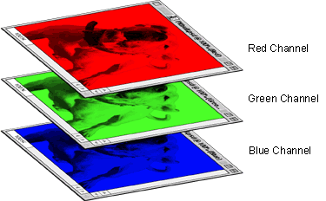
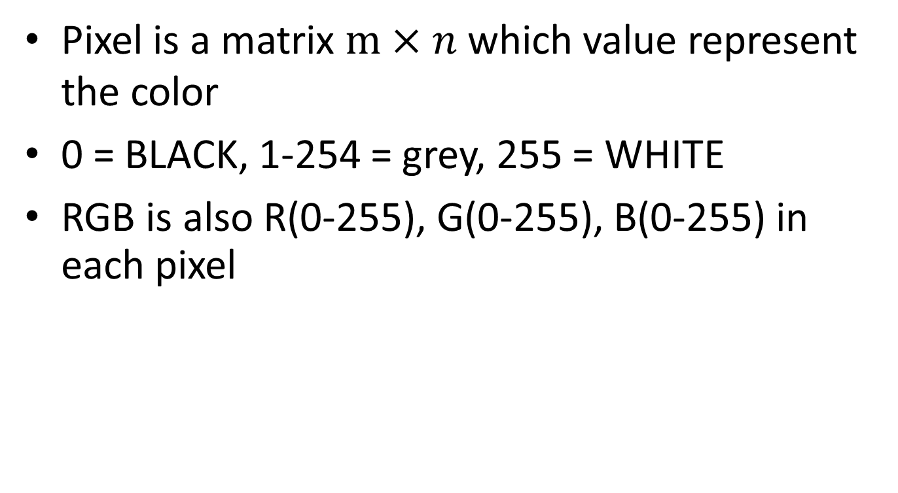
Background Knowledge
Pixel is a matrix $m×n$ which value represent the color
0 = BLACK, 1-254 = grey, 255 = WHITE
RGB is also R(0-255), G(0-255), B(0-255) in each pixel

Slide 4
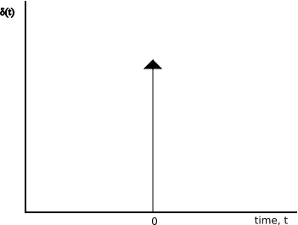
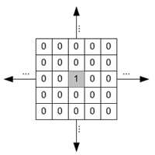
Background Knowledge
Impulse response(1D)
= Kernel(2D)
= MASK(2D)
Continous time
Discrete time
Discrete time

Slide 5
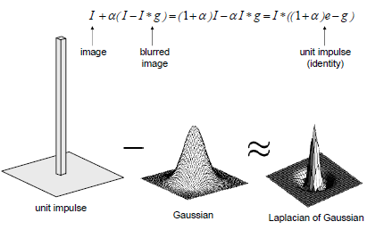
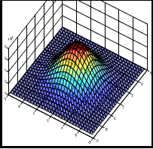

Slide 6
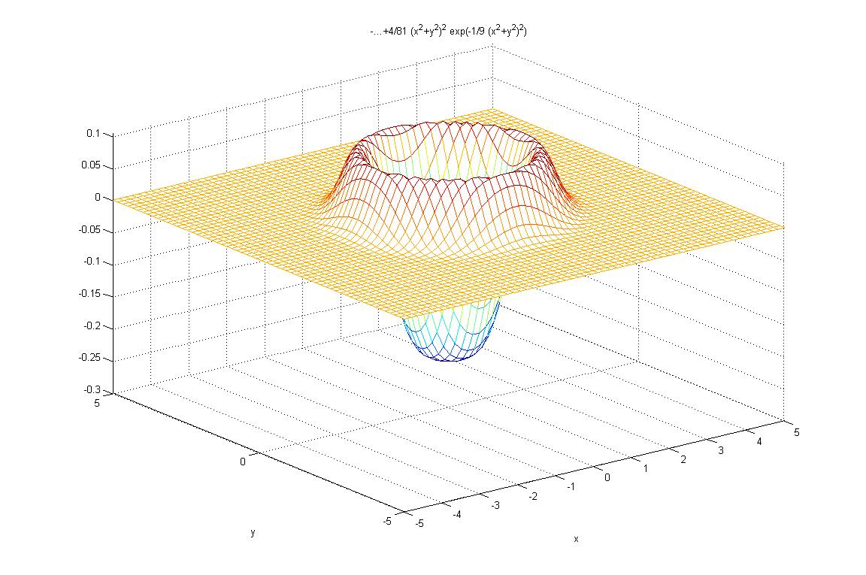
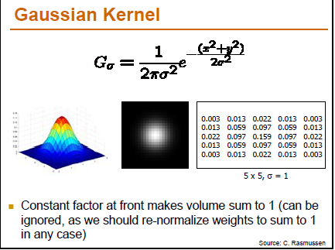
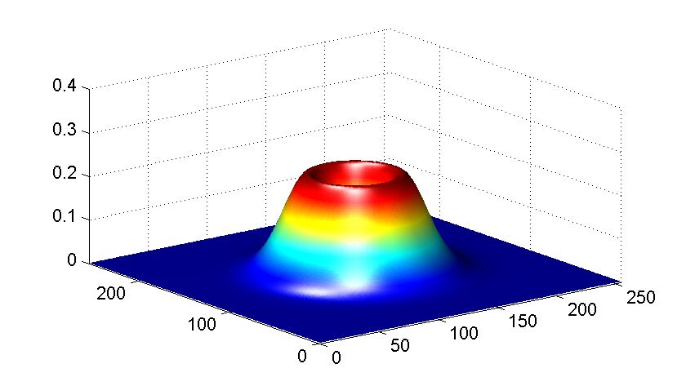

Slide 7
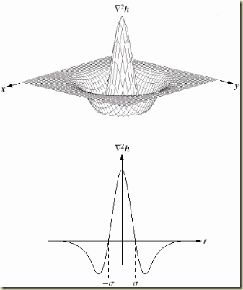
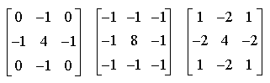
Background knowledge
Kernel in discrete time
Model of kernel in continuous

Slide 8
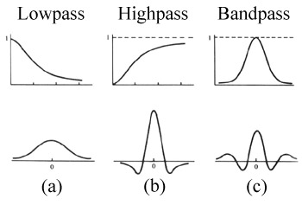
Background Knowledge

Slide 9
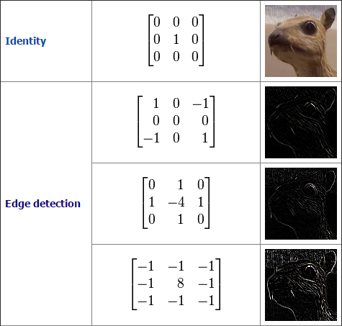
Background Knowledge

Slide 10
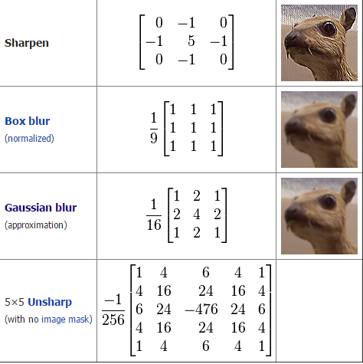
Background knowledge

Slide 11

Background knowledge
We will use a lot of 2D convolution operator

Slide 12
Background knowledge
2D Convolution will be available if center of kernel overlap to input picture.
If some cell in kernel doesn’t overlap input picture, we don’t consider it or equal to zero(0)
Kernel will move around input cells respectively.

Slide 13
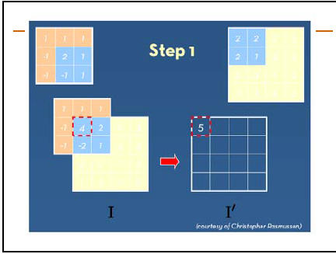
Background knowledge
Kernel
I’(0,0)= 0+0+0+0+2x2+1x2+0+(-1)x2+1x1=5

Slide 14
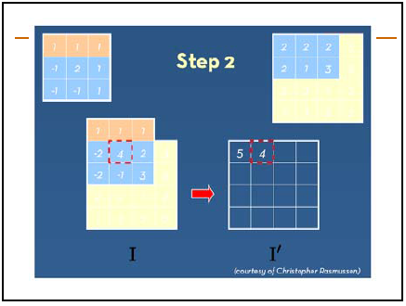
Background knowledge
I’(1,0)= 0+0+0+(-1)x2+2x2+1x2+(-1)x2+(-1)x1+1x3=4

Slide 15
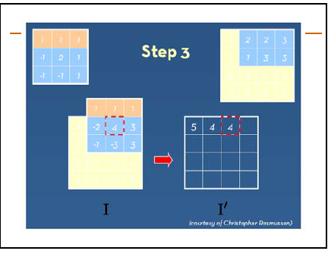
Background knowledge
I’(2,0)= 0+0+0+(-1)x2+2x2+1x3+(-1)x1+(-1)x3+1x3=4

Slide 16
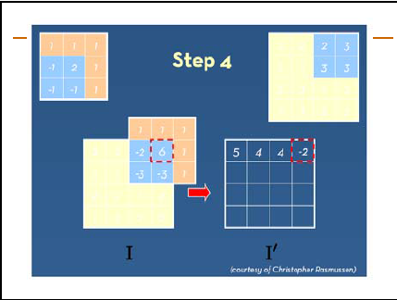
Background knowledge
I’(3,0)= 0+0+0+(-1)x2+2x3+0+(-1)x3+(-1)x3+0=-2

Slide 17
Background knowledge
Sum of coefficient of each cell of kernel must be 1
If it is higher than 1. it will be brighter. (255 = White)
If not, it will be darker (0 = BLACK)

Slide 18
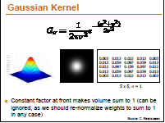
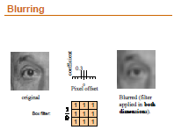
Background knowledge
Blurring or Smoothing
- Mean filter
- Gaussian filter
- Median filter

Slide 19
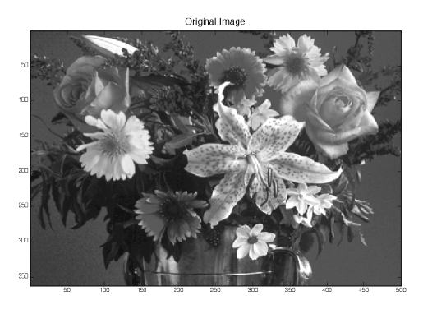
Background knowledge

Slide 20
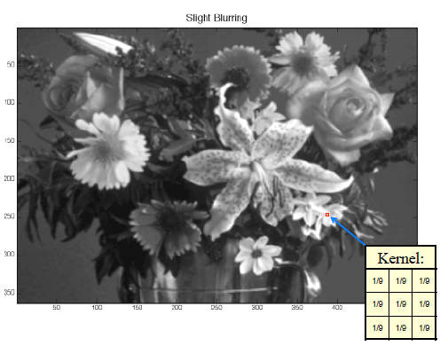
Background knowledge

Slide 21
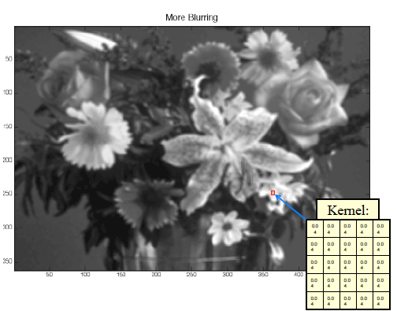
Background Knowledge

Slide 22
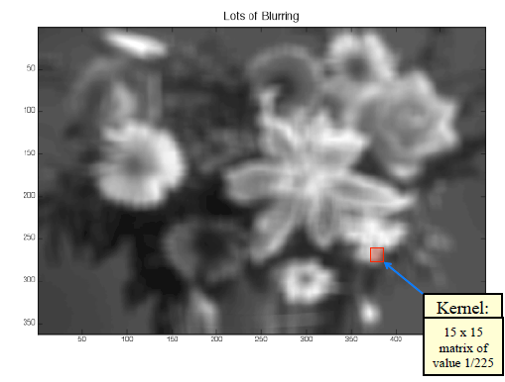
Background knowledge

Slide 23
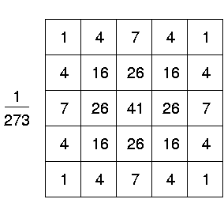
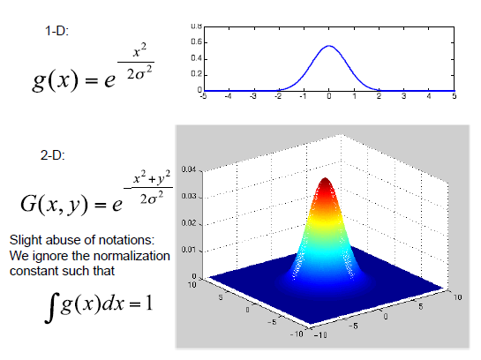
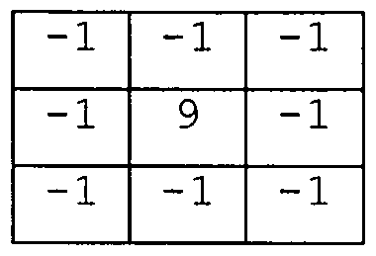
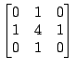
Background Knowledge
Gaussian equation

Slide 24
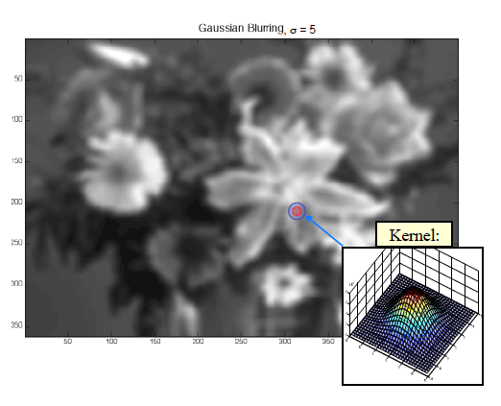

Slide 25
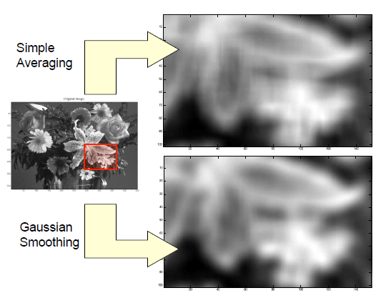
Background knowledge

Slide 26
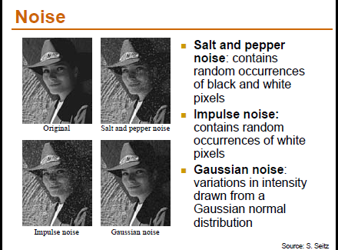
Background knowledge

Slide 27
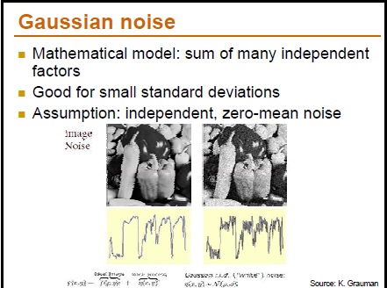
Background knowledge
We can reduce noise by using blurring or smoothing

Slide 28
High boosting filter
In image processing, it is often desirable to emphasize high frequency components representing the image details without eliminating low frequency components (such as sharpening). The high-boost filter can be used to enhance high frequency component.

Slide 29
High boosting filter
High boost filter is composed by an all pass filter and a edge detection(high pass) filter (laplacian filter). Thus, it emphasizes edges and results in image sharpener.

Slide 30
All pass filter
We know that if we have input. We then convolute it with delta function. Output will be the same as input. Therefore, it calls all pass filter

Slide 31
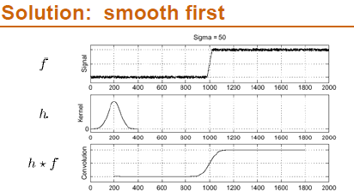
Blurring and Smoothing
A low-pass filter, also called a "blurring" or "smoothing" filter, averages out rapid changes in intensity.

Slide 32
High pass filter
All pass - Low pass = High pass
Same - Blurring = Edge detection

Slide 33
Edge detection
Sometimes, it’s difficult to find edge because of noise(high frequency).
We use blurring or smoothing to reduce noise.
However, if picture is clear, we don’t need to blur or smoothing. If we blur or smooth clear picture, it will be difficult to find edge. Therefore, don’t blur it sometimes.

Slide 34
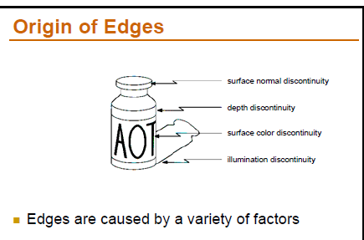
Edge detection

Slide 35
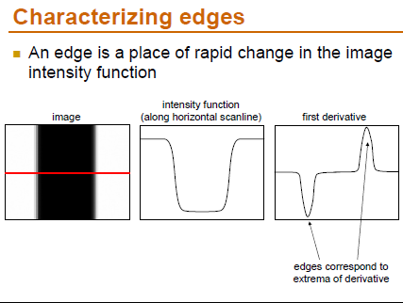
Edge detection

Slide 36
Edge detection
We know that edge caused of suddenly changed intensity.
We can use first order of differential (In 2D, we call gradient operators such as Roberts, Sobel and Prewit)
We can also use second order of differential or Laplacian operator to find zero crossing that a point that have difference of 2 point opposite color

Slide 37
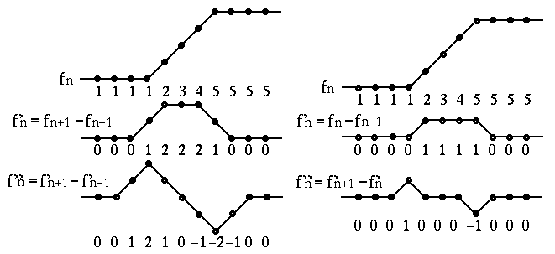
Edge detection

Slide 38
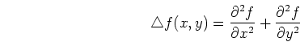
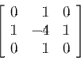
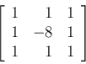
Laplacian Operator
When applied to a 2-D function , this operator produces a scalar function:’
In discrete, 2D function
KERNEL

Slide 39

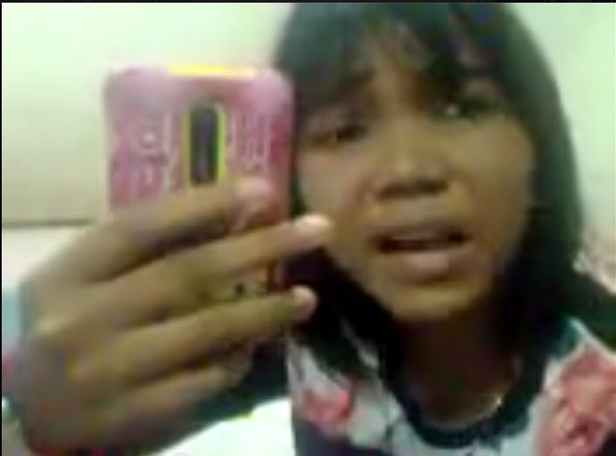
Original Image
NiaoKai (Already blurring, No Noise)
Lenna (Look clear, with Noise but we can’t see)

Slide 40
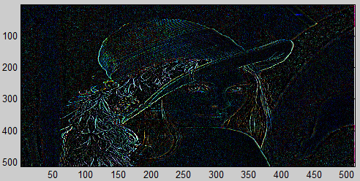
Find edge
After edge detection by Laplacian 3x3 Kernel More noise without Blurring

Slide 41
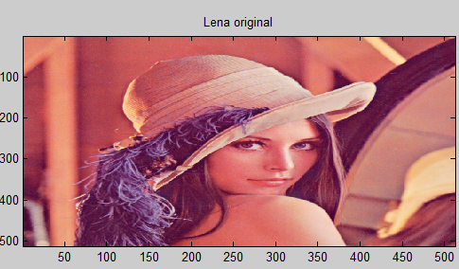
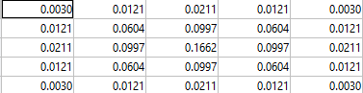
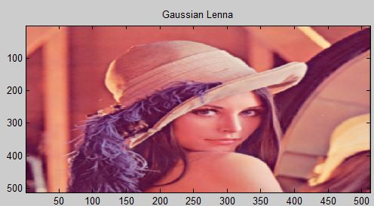
Blurring
Blurring by using Gaussian filter

Slide 42
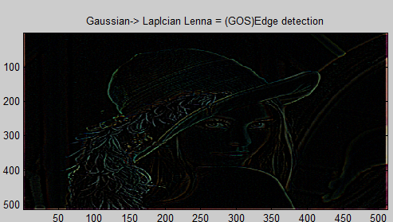
Find edge before blurring

Slide 43
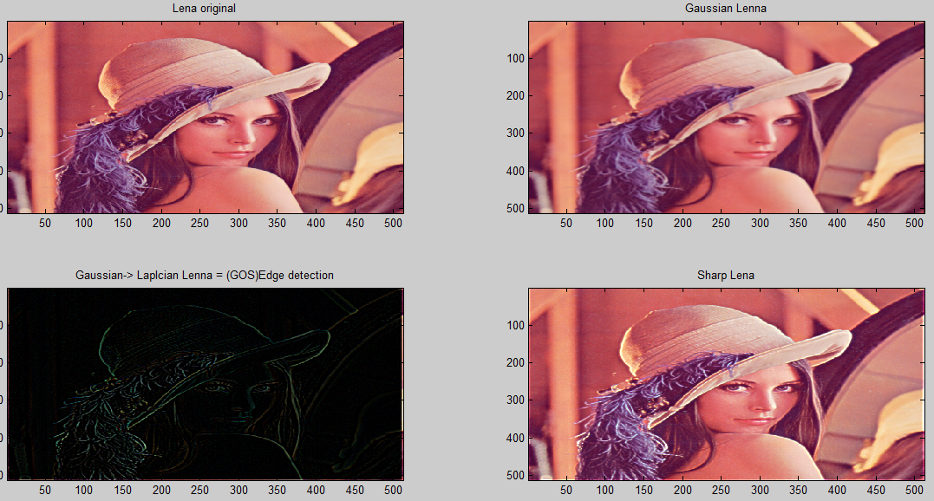
High boosting filter
Finally, we add edge to original image which means we emphasize all edge in the picture

Slide 44
Linearity
In process before, We find edge first and add them to original.
On the other hand, we can modify kernel to convolution one time and get a sharpen image

Slide 45
Lineraity
Blur(Low pass) image -> Subtract original image -> Get edge(High pass)-> Add to original image -> Sharpen image {Original(All)-Blur(Low) = Edge(High) -> Original(All)+Edge(High) = Sharpen
Laplacian(High pass) -> Get edge -> Add to original image -> Sharpen
Laplacian = Original - Blur

Slide 46
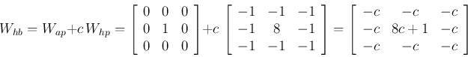


Kernel
Delta function(All)+ Coefficient*Laplacian(High pass) convolute with original image = Sharpen

Slide 47


High boosting filter
Coefficient = 2

Slide 48


Niaokai Example
Coefficient = 2

Slide 49


Frequency response
High pass = Delta function + Coefficent* Laplacian

Slide 50


Frequency Response
Low pass (Gaussian For blur)

Slide 51


Frequency Response
High pass Laplacian (Edge detection)

Slide 52


Frequency Response
All pass (Same picture)

Slide 53

Block diagram
lena4.m

Slide 54

Block diagram
lena5.m

Slide 55

Block diagram
lena6.m

Slide 56
Reference
http://fourier.eng.hmc.edu/e161/lectures/gradient/node7.html
http://oscar.iitb.ac.in/OSCARPP/Electrical%20Engineering/UploadedStoryboards/High%20Boost%20filtering.ppt
http://alumni.media.mit.edu/~maov/classes/vision09/lect/09_Image_Filtering_Edge_Detection_09.pdf

Slide 57
Members
Mr. Siwat Kaolueng ID 56070503434
Mr. Naiprakarn Nakornkhet ID 56070503419
Mr. Saurawit Sanguanphokai ID 56070503437
Mr. Sarun Keiwkajee ID 56070503467

